Slide 1

Health Risk Prediction Web App
Predicting Risk for High Blood Pressure, Diabetes, and Anxiety Disorders
Christian Kerns
IS 3600, Final Project

Slide 2
Project Overview
Goal: Build a web app that predicts health risks based on user input
Key Conditions Predicted:
High Blood Pressure
Diabetes
Anxiety Disorders
Technologies used:
AWS SageMaker (Canvas)
Flask (Python API)
Google Colab (Data cleaning)
EC2 (Instance)
S3 (Dataset Storage)
Frontend (HTML)

Slide 3
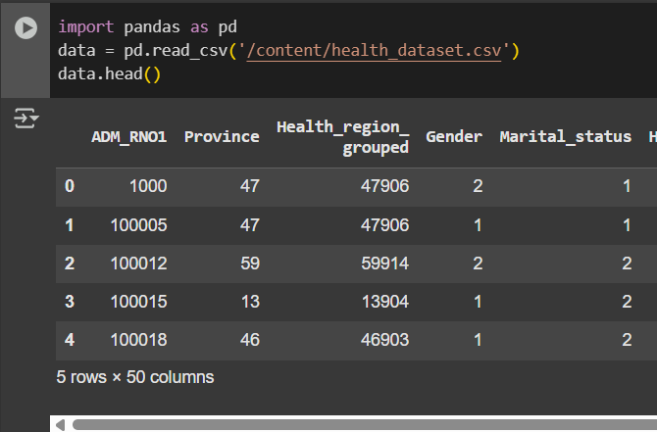
Dataset Used
Source: health_dataset from Kaggel
This dataset contains anonymized responses from the Canadian Health Survey (2019-2020), providing valuable insights into various health-related factors, lifestyle choices, and medical conditions of individuals across different provinces
Features: Age, Gender, Smoking, Activity Level, BMI, Stress, etc.
Rows: 108,253

Slide 4
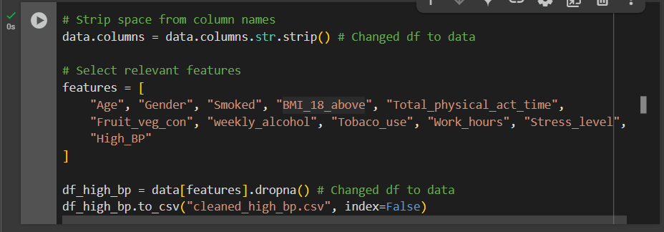
Data Cleaning Process
Tools used: Google Colab / Pandas
Removed null values, standardized column names
Selected relevant features for modeling
Created 3 separate datasets for each condition

Slide 5
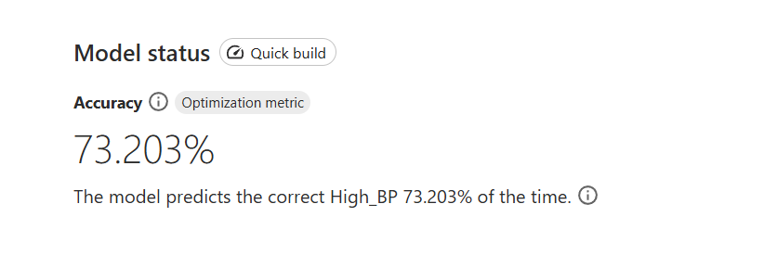
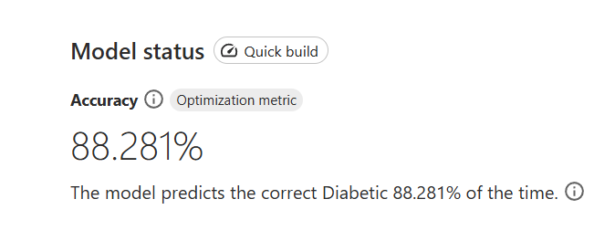
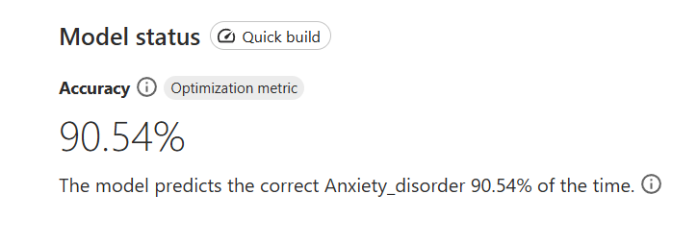
Machine Learning Model (Canvas)
Used SageMaker Canvas for no-code model training
Quick Build for High_BP, Diabetic, Anxiety_Disorder targets

Slide 6
Flask API Integration
Deployed app using Flask on EC2
Created route that connects to the model endpoints
Accept sample input and returns 3 risk predictions

Slide 7
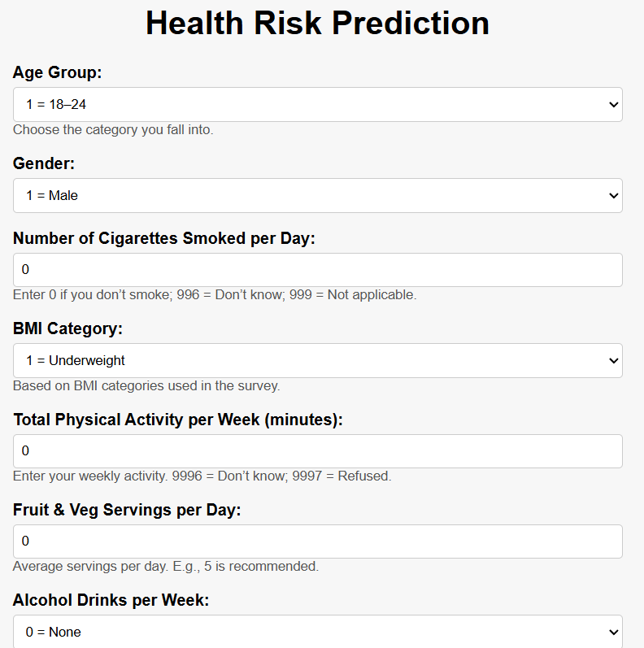
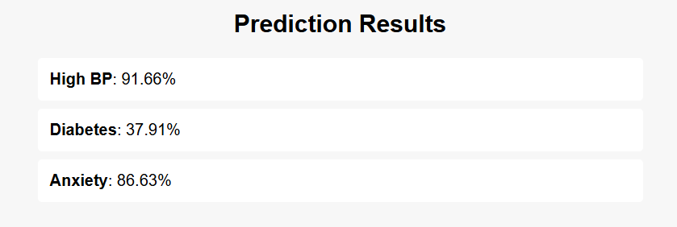
Sample Input and Output
Sample input example (age, BMI, stress level, etc.)
Example prediction output

Slide 8
Final Architecture Overview
Visual diagram:
User Input > Flask API with SageMaker Endpoints > EC2 instance with Frontend (HTML) > Risk Results
Technologies:
AWS SageMaker (Canvas)
Flask (Python API)
Google Colab (Data cleaning)
EC2 (Instance)
S3 (Dataset Storage)
Frontend (HTML)

Slide 9

Demo

